Slide 1



BAN6800: Business Analytics Capstone
Milestone 2 Assignment: Business Analytics Model Results Communication
T-Mobile USA Customer Churn Prediction Model Results
Name: Onimisi David Adidi
Learner ID: 149525
Notes:
Good day all, I am Onimisi David Adidi. I am a student in the course BAN6800: Business Analytics Capstone. Here is my presentation on T-Mobile USA Customer Churn Prediction Model Results. Today, we’ll review the findings of our predictive model, the business problem we addressed, and actionable recommendations for reducing churn and enhancing customer retention.

Slide 2
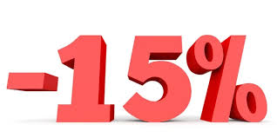
INTRODUCTION
GOAL:
Notes:
The proposed research is designed to respond to the critical problem of customer churn in T-Mobile. Through complex data analysis, our main target is to help to achieve the goal of 15% of churn rate reduction.

Slide 3
BUSINESS PROBLEM
High customer churn impacting profitability.
Major causes: pricing, service quality, and lack of personalization.
Notes:
This is because customer churn rate in T-Mobile industry is high and this specifically happens to affect revenues and market share. Churn us caused by pricing, perceived service quality, and lack of personalized communication.

Slide 4

SOLUTION
Predictive model using Logistic Regression and Random Forest.
Integration of demographic and transaction data.
Features engineered: customer tenure, monthly spend.
Notes:
This is a big improvement because our solution is based on a predictive model that reveal who is at risk among the customers. Through demographic and transactional data, we created first level features such as Monthly Tenure, Churn Value to improve the model.

Slide 5
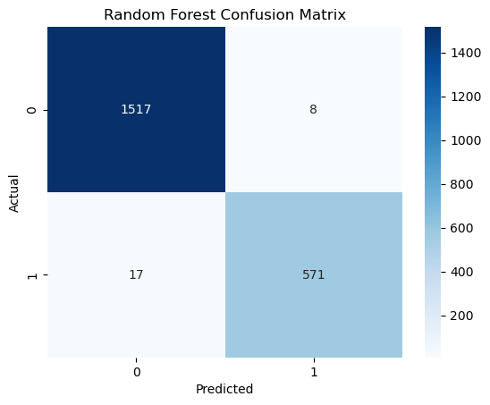
Model PERFORMANCE
Logistic Regression - Accuracy: 93%, AUC-ROC: 0.99
Random Forest - Accuracy: 99%, AUC-ROC: 0.99
Visuals: Confusion matrix.
Notes:
In the prediction model, the Random Forest kept an excellent performance where it had 0.99 AUC-ROC and 99% Accuracy. This shows high predictive ability of the model in terms of customers who are likely to churn.

Slide 6
DATA INSIGHTS
Key drivers of churn: low tenure, high monthly charges, low engagement scores.
High-risk segments: customers with tenure <1 year and high data usage.
Notes:
Our analysis revealed that low tenure and high monthly charges are the most significant predictors of churn. New customers using more data are the most vulnerable Customers.

Slide 7
BUSINESS VALUE
Proactive retention strategies targeting at-risk customers.
Estimated savings from reduced churn.
Enhanced customer lifetime value (CLV).
Notes:
In identifying and subsequently appealing to at-risk T-mobile customers, the company will be able to save costs in a given year while increasing overall customer value and, in the process, customer loyalty, therefore achieving more profitability in the long run.

Slide 8
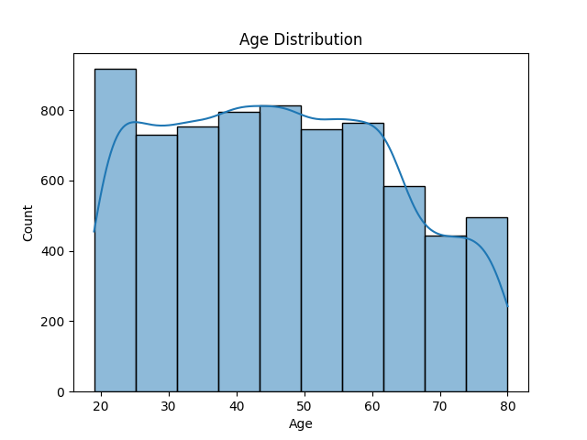
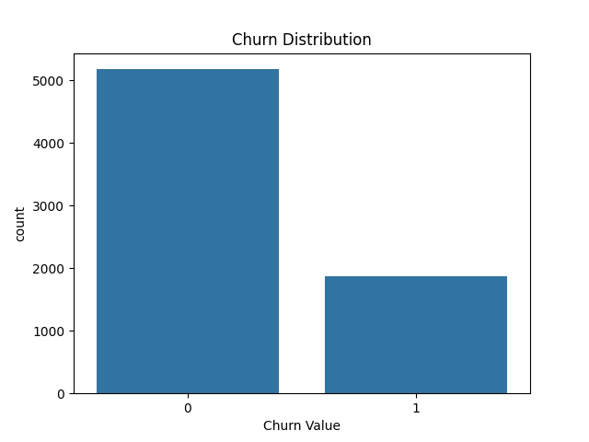
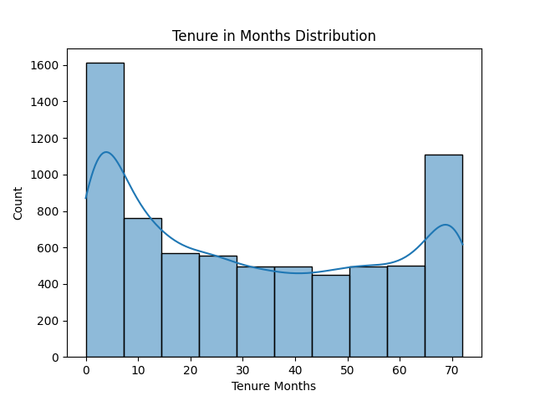
DATA VISUALIZATIONS
Churn distribution across the dataset.
Risk segmentation by customer demographic.
Notes:
Among these metrics, the churn rate and its relation to customers grouped according to their risk profile enables the definition of resource allocation areas.

Slide 9

OUR RECOMMENDATIONS
Launch personalized retention campaigns for high-risk customers.
Introduce loyalty programs for low-tenure customers.
Enhance service quality to address pricing concerns.
Notes:
We suggest carrying out intensive retention strategies like loyalty programs while improving the quality of services to meet customer complaints.

Slide 10
CONCLUSION & NEXT STEPS
Recap: Insights, model performance, and key recommendations.
Call to action: Implement retention strategies to achieve business goals.
Notes:
In Conclusion, it can be said that our developed predictive model will help in minimizing the churn. This paper makes the following recommendations which when implemented by the firm will assist it reach its goal of having a churn rate of 15%.

Slide 11


